Slide 1

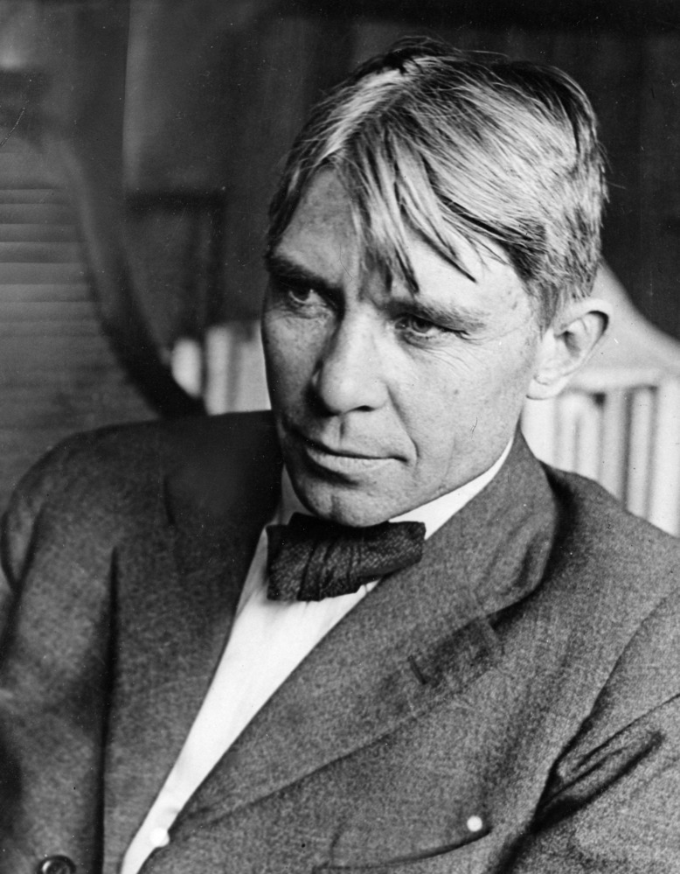
"Poet of the People“
Carl Sandburg provided a popular voice for the American people of the twentieth century and still speaks to us through his words, activism, music and the beauty and serenity of Carl Sandburg Home National Historic Site.
www.nps.gov/carl

Slide 2
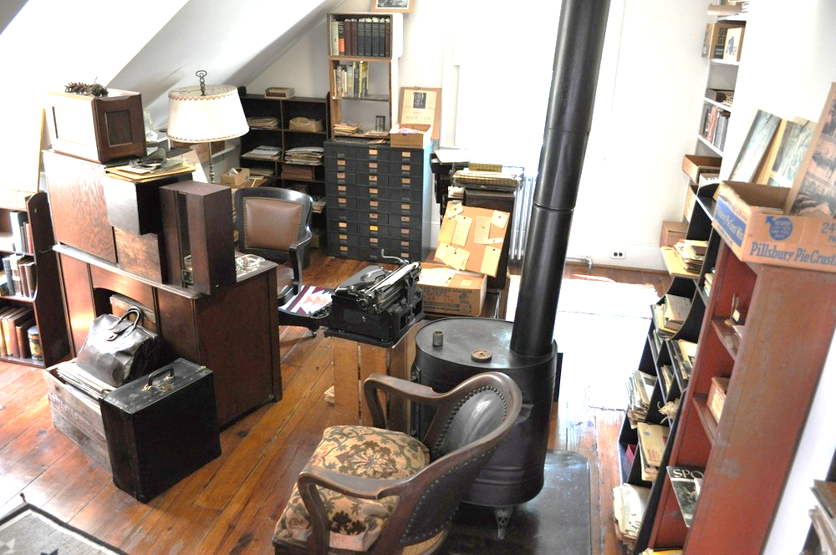
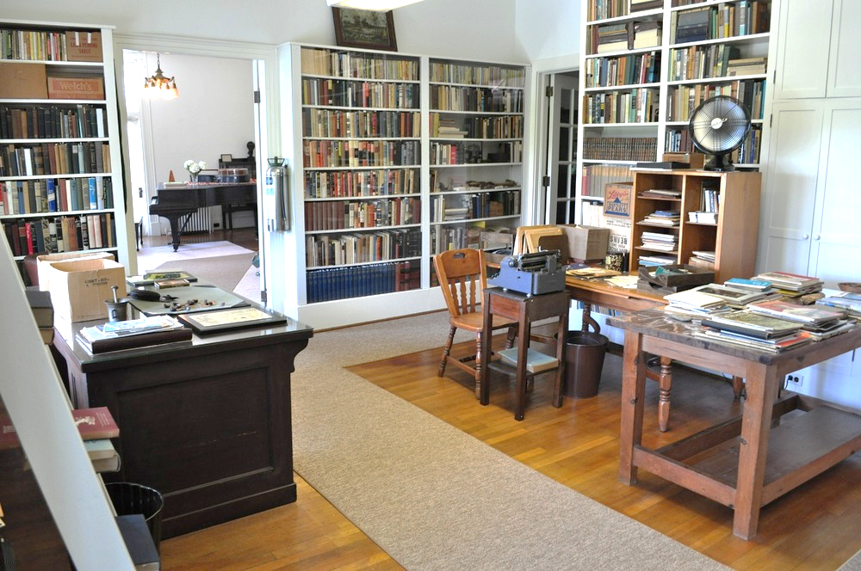
Carl Sandburg’s Connemara
Grades 3rd - 5th
Carl Sandburg lived at Connemara for the last 22 years of his life. What inferences can you make about Carl Sandburg based on the objects he had in his home?
Tasks:
1) Complete the activating strategy on slide 3. What object describes you?
2) Watch a video to learn about Carl Sandburg’s Connemara on slide 4. Make notes about what you see in the house.
3) Take a Virtual Tour of Connemara on slide 5.
4) Write to explain what you infer about Carl Sandburg’s book library and why it was important to his life on slide 6.
Vocabulary tip.
To infer is to deduce or conclude (information) from evidence and reasoning rather than from direct statements.

Slide 3
If you were to pick just one object to describe you what would it be?
Insert a picture of that object and write to explain why that object describes you.
What does that object tell someone about you?
Place object in this box
Write your answer here:

Slide 4
Carl Sandburg’s Connemara
Click this link https://www.youtube.com/watch?v=jS0TJT6H_KE
to learn about Carl Sandburg’s Connemara.
As you watch you can pause the video and make notes about what objects you see in his house.
What objects do you see in Carl Sandburg’s home that you also have in your home?
Why are those objects important?

Slide 5

Click this link https://carl.oncell.com/en/sandburg-home-tour-92015.html to take a virtual tour to explore Carl Sandburg Home NHS.
As you take the tour, think about what you notice about Carl Sandburg’s home.
How is it similar or different to your home?
What evidence can you find that words were important to Carl Sandburg?
How could you prove that Carl Sandburg lived simply?

Slide 6
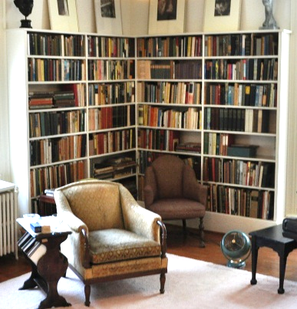
What inference can you make about Carl Sandburg having 10,000 books in his house? What do these objects tell you about him?
In his autobiography, “Always the Young Strangers,” Carl Sandburg wrote that as a young boy “I had books I didn’t have to take back to the Seventh Ward school or the Public Library…I was a book owner.” As an adult, Carl Sandburg had more than 10,000 books in his home.
Write your response here…

